Slide 1




Putting nutrition at the heart of sustainable diets
Ian Givens
Professor of Food Chain Nutrition
Director, Institute for Food, Nutrition and Health
University of Reading

Slide 2



2010
What is a sustainable diet?
…those diets with low environmental impacts which contribute to food and nutrition security and to healthy life for present and future generations. Sustainable diets are protective and respectful of biodiversity and ecosystems, culturally acceptable, accessible, economically fair and affordable; nutritionally adequate, safe and healthy; while optimizing natural and human resources.
How can we achieve a dietary pattern that provides us with the many nutrients we need for health, in appropriate amounts, but that is also equitable, affordable and sustainable? And, how do we produce more food with fewer resources, such as land, water and fuel, to feed the growing global population?

Slide 3
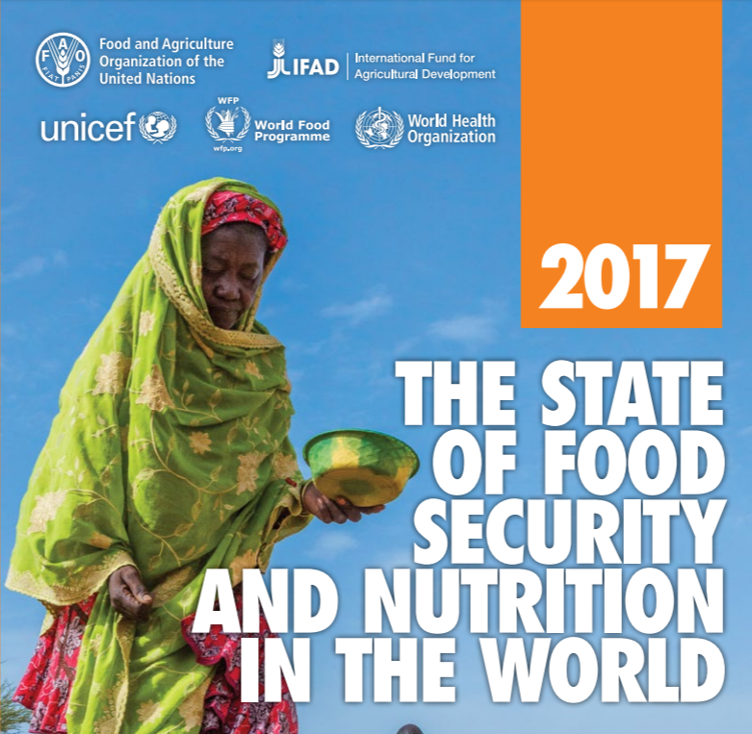
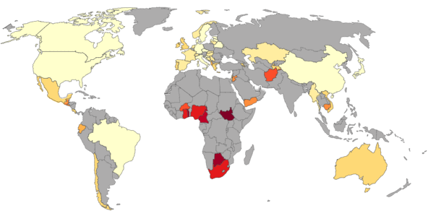



Food security at different levels
World
Country
Regions
within
country
Age/gender
Food security
≠
Nutrient security

Slide 4
WORLDWIDE FOOD SECURITY

Slide 5

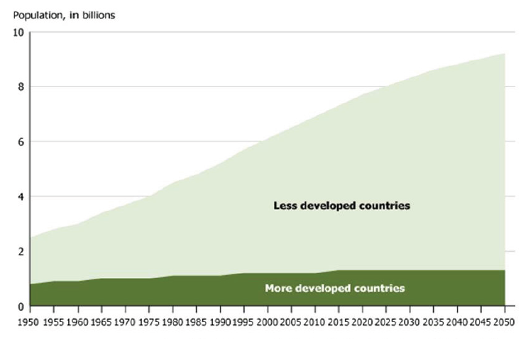

Feeding an increasing world population
9.3
7.3
7.324 billion in world

Slide 6

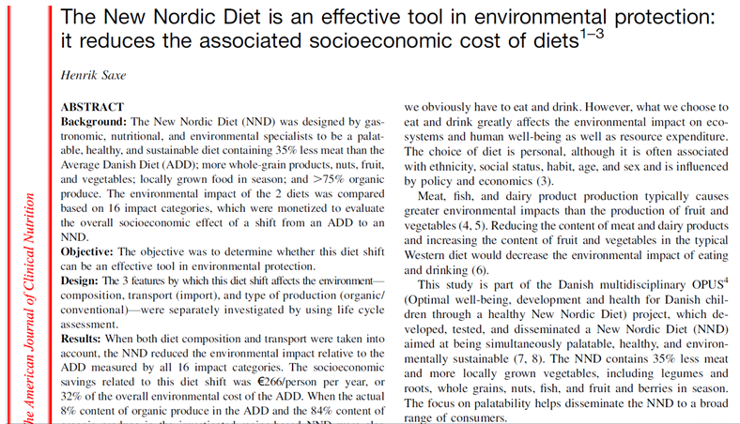

COUNTRY FOOD SECURITY

Slide 7
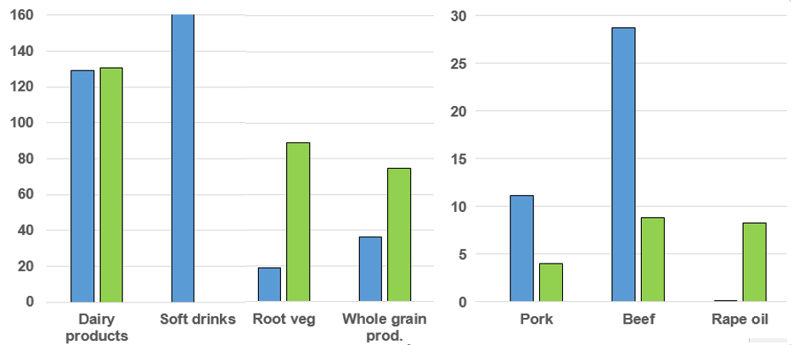
New Nordic (NND) vs. average Danish diet (ADD)
Saxe, 2014
ADD
kg/person/year
kg/person/year
NND
0
0.1

Slide 8
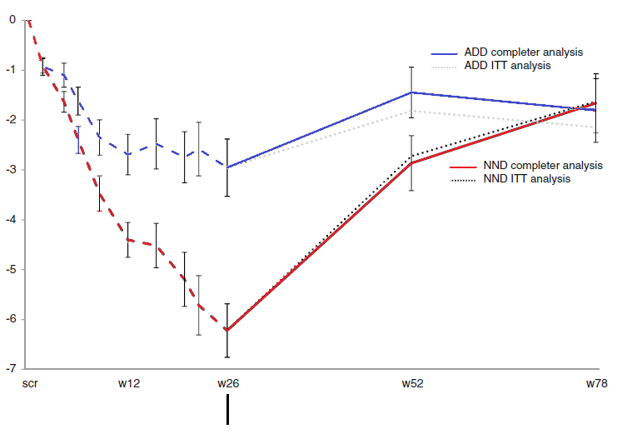
Changes in BW on new Nordic (NND) and average Danish diet (ADD)
Poulsen et al., 2014
Change in BW (kg)
Intervention
Follow up
Weeks

Slide 9
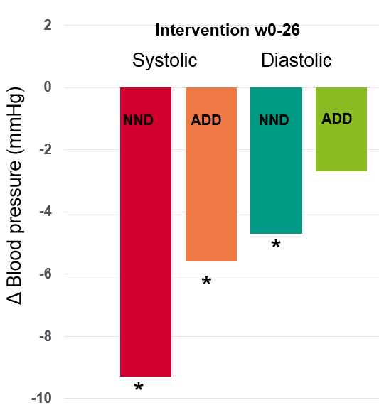
Changes in BW on new Nordic (NND) and average Danish diet (ADD)
Poulsen et al., 2014
Change in BW (kg)
Intervention
Follow up
Weeks

Slide 10
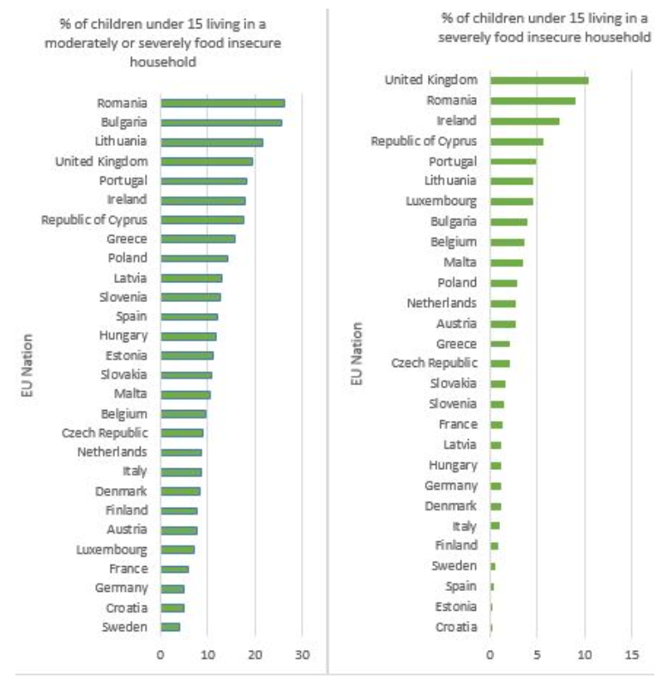

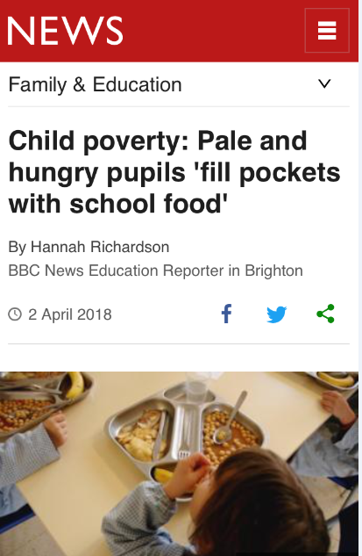
Substantial and vulnerable sections of the UK population do not have food security now!
2017

Slide 11
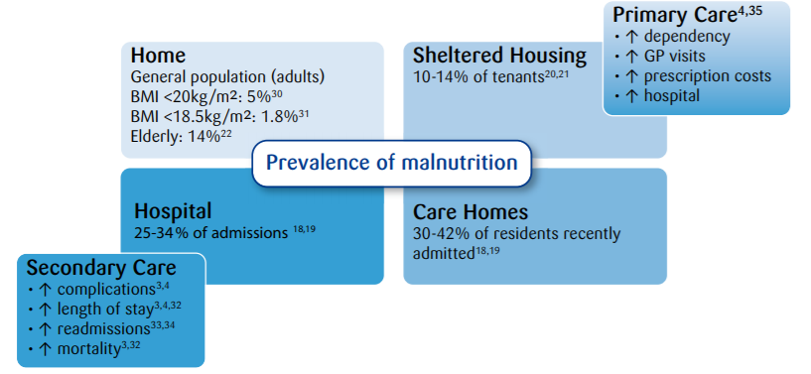

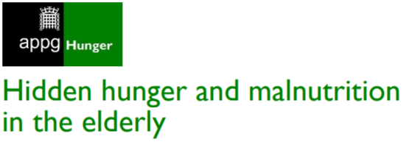
Prevalence of malnutrition in UK elderly
Annual cost to UK health services £13-19 billion
2018

Slide 12
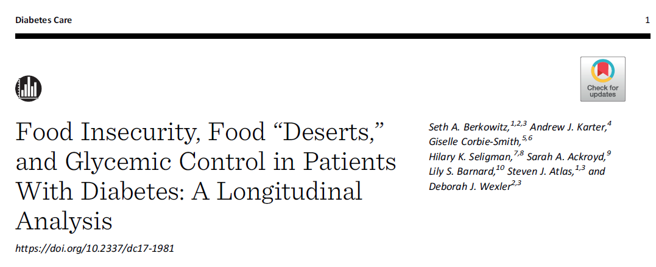
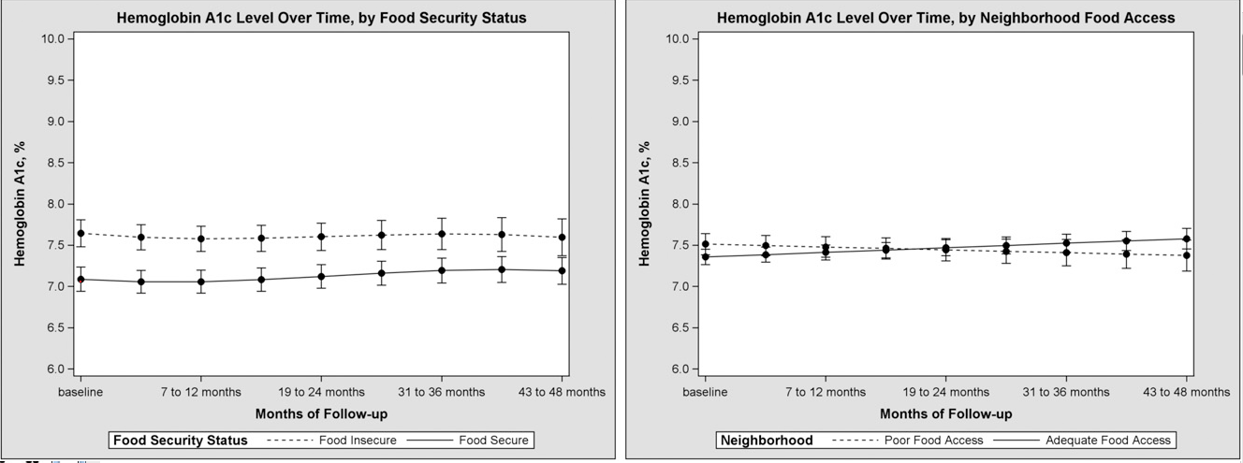
Food Security Status
Food Access
insecure
adequate
poor
secure

Slide 13

UK NUTRIENT INSECURITY

Slide 14
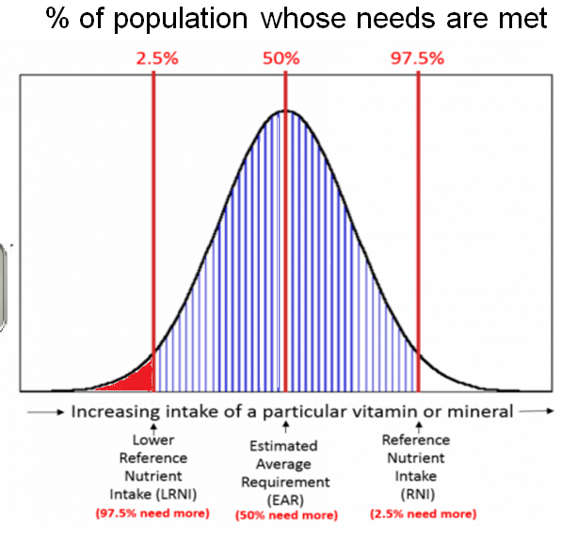
Micronutrient status of UK children and adult females
%<LRNI

Slide 15
Dairy food intake in UK females
NDNS 2014, Y1-4 combined
Intake (g/d)
Age range

Slide 16
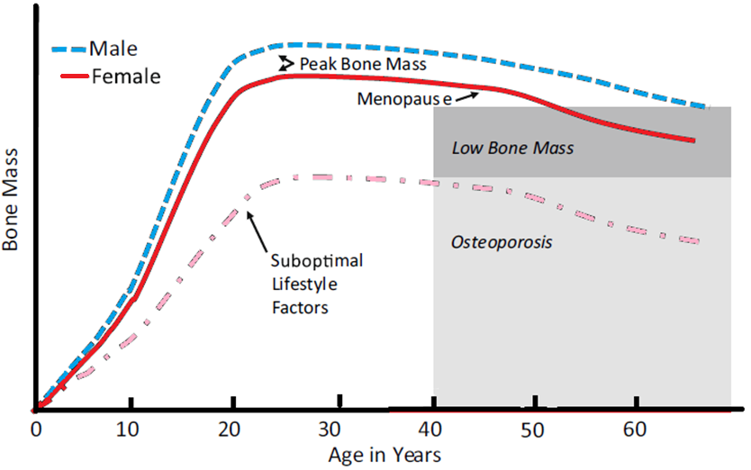
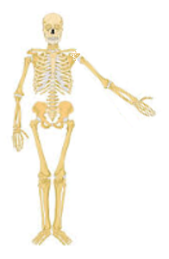
Bone mass changes with age
Weaver et al. (2016)

Slide 17
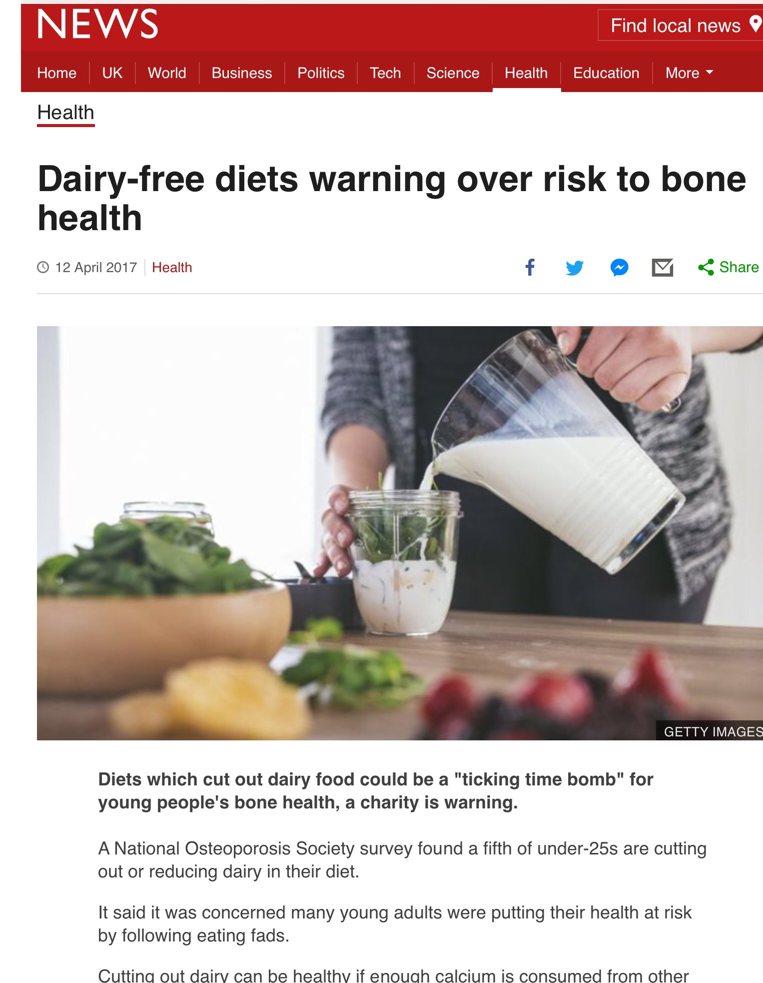
Bone mass changes with age
Weaver et al. (2016)

Slide 18
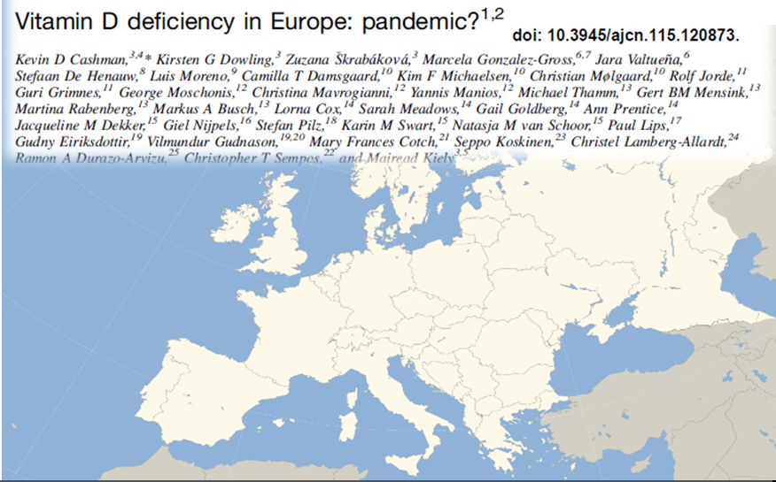
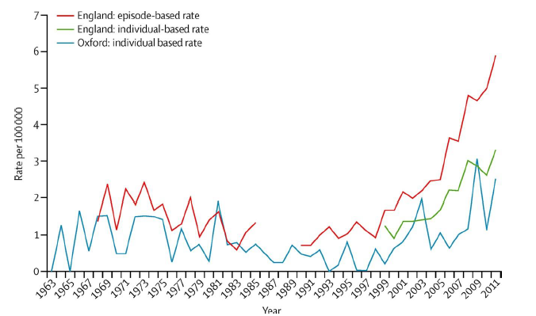
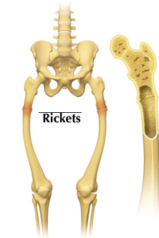
Sub-optimal vitamin D status
across Europe
UK childhood rickets

Slide 19
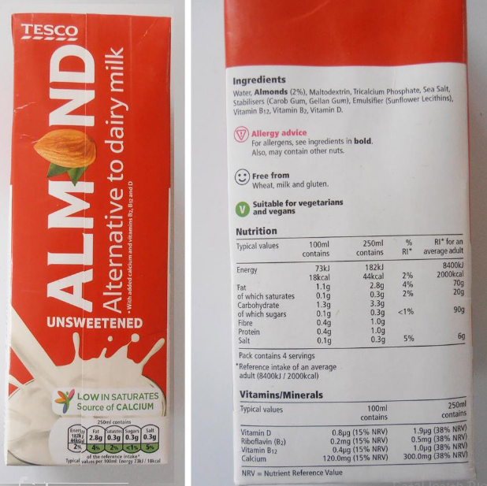
Protein quality for bones?

Slide 20
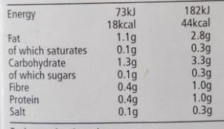
Protein quality for bones?

Slide 21
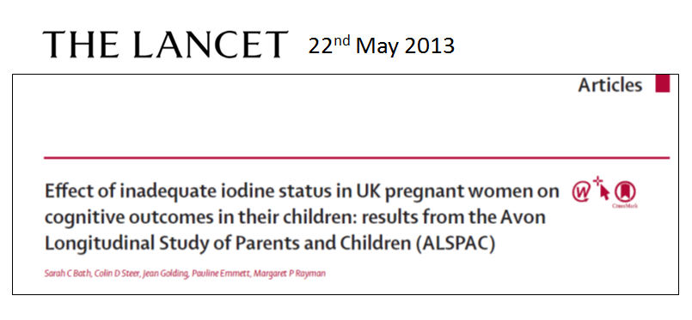
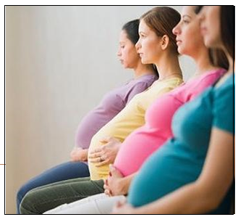
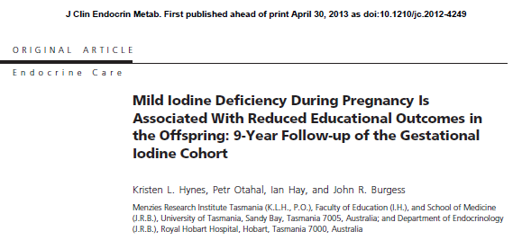
Recent studies of UK iodine status
Recent UK studies have shown sub-optimal status in:
Women of childbearing age¹⁻³
Pregnant women⁴⁻⁷
1. Bath et al. 2008; 2. Rayman et al. 2008; 3. Lampropoulou et al 2012 4.Kibirige et al. 2004;
5.Barnett et al. 2002; 6. Bath et al. 2010; 7. Pearce et al 2010

Slide 22
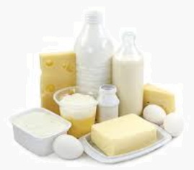
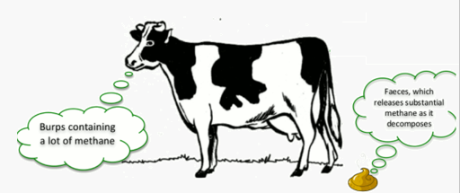
IS Milk/DAIRY TOO
ENVIRONMENTALLY COSTLY?

Slide 23
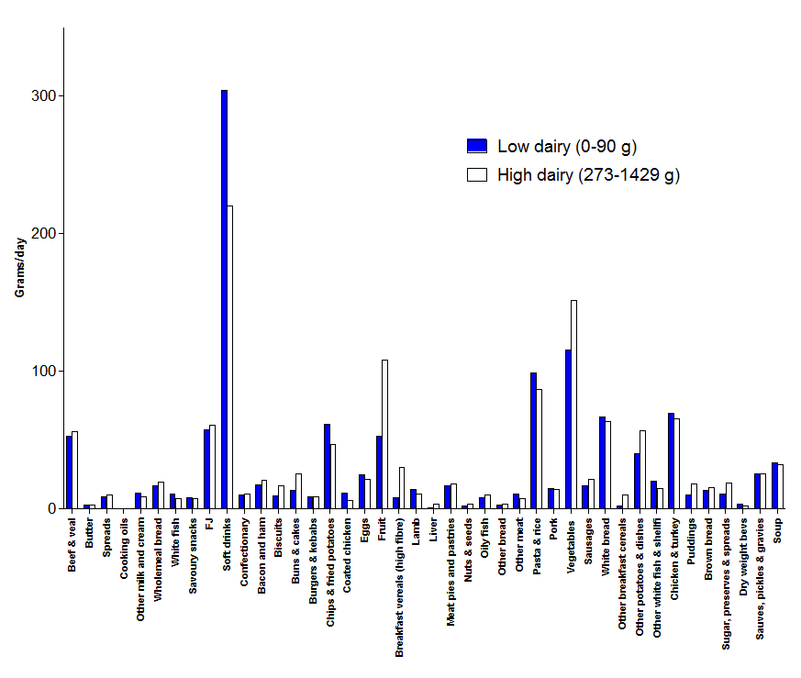
UK dietary pattern by daily intake of dairy portions
Hobbs et al. under review
Grams/day
Modelling the current male UK adult (19-64 y) diet (NDNS 2014)

Slide 24
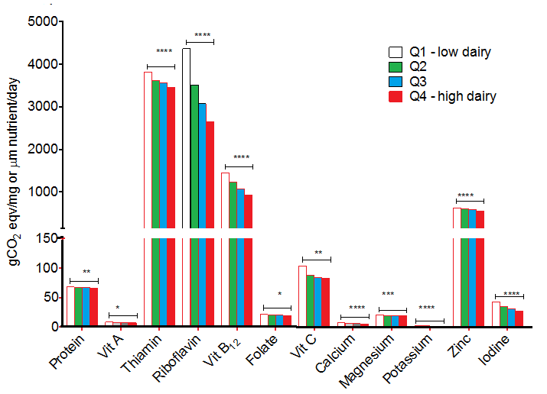
Greenhouse gas eq/unit nutrients
Hobbs et al. under review

Slide 25
Recent meta-analyses of prospective studies on dairy and cardiometabolic diseases
Dairy | Outcome | RR (95% CI) | Ref
Milk | AC mortality | 1.00 (0.93-1.07) | Guo et al., 2017
Milk | CVD | 1.01 (0.93-1.10) | Guo et al., 2017
Cheese | CVD | 0.98 (0.95-1.00) | Guo et al., 2017
Milk | Stroke | 0.93 (0.88-0.98) | De Goede et al., 2016
Cheese /40 g/d | Stroke | 0.97 (0.94-1.01) | De Goede et al., 2016
Yoghurt/80g/d | Diabetes | 0.86 (0.83-0.90) | Gijsbers et al., 2016

Slide 26



Milk proteins and blood pressure
Peripheral SBP & DBP
mmHg
p=0.023
p=0.002
Central SBP & DBP
Overall treatment effect for C_SBP p=0.010,
Overall treatment effect for C_DP p=0.094,
Overall treatment effect for C_MeanP p=0.024
n=38, Means ± SEM
p=0.004
p=0.022
Whey protein
Ca-caseinate
Control
mmHg
Overall treatment effect for P_SBP p=0.007,
Overall treatment effect for P_DP p=0.095,
Overall treamtent effect for P_MeanP p=0.009
n=38, Means ± SEM
Fekete et al., AJCN (2016)
Whey protein
Ca-caseinate
Control
Notes:
Applanation Tonography of radial artery allows the measurement of central pressures.
Forty-two participants were randomly assigned to consume 2 x 28 g whey protein/d, 2 x 28 g Ca caseinate/d, or 2 x 27 g maltodextrin (control)/d for 8 wk separated by a 4-wk washout.

Slide 27
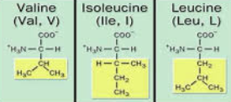
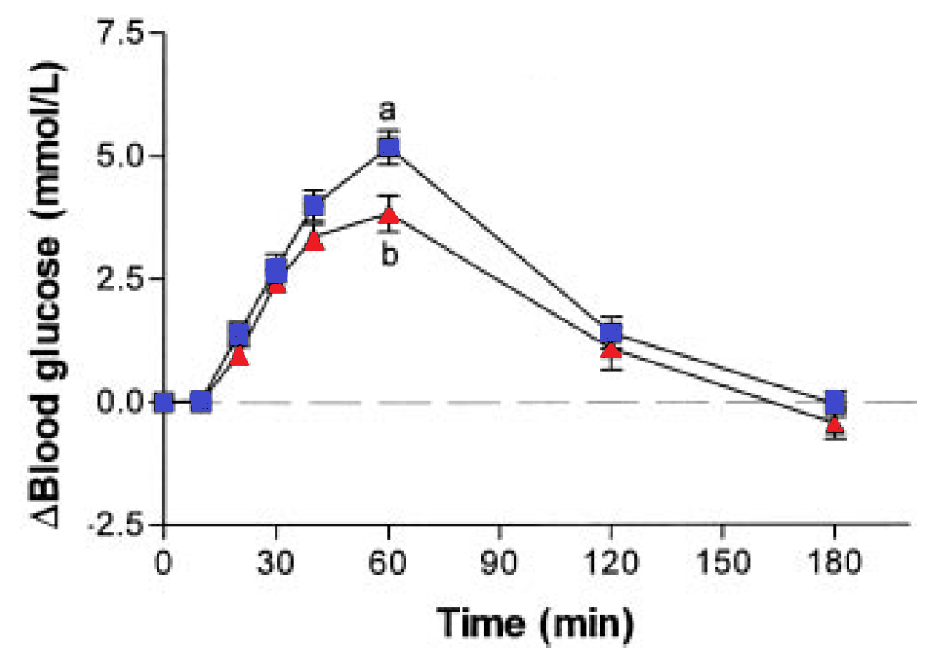
Carbohydrate-rich meal +/- whey protein on blood glucose in T2DM patients
Frid et al., 2005
+ 28g whey
P, Treat x time = 0.022

Slide 28
A few conclusions…
There are different levels of food security and achieving them will require different solutions if indeed achievable..
The UK may be currently ‘food secure’ but significant sections of the population are not and this is not widely known….
Many children and young females in the UK are certainly not nutrient secure…
Whilst the world issue is important, much more effort is needed to fix our ‘local’ issues..
Declines in milk consumption have already had consequences and…risk of poor bone development especially in girls is concerning and may become a major issue
Milk/dairy foods are key sources of important nutrients but have functionality beyond nutrient supply
Dietary pattern, nutrition and health must be included in any debate about sustainable food production…..

Slide 29
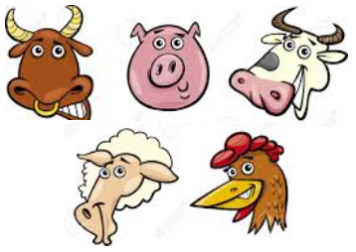
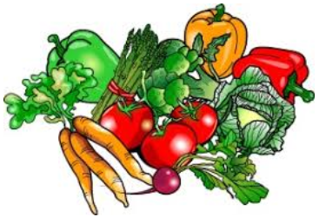




It’s more complicated than….
VS.
THANK YOU

